Slide 1
Web Development Nanodegree
Session 1
Conducted by: Hamza
Notes:
https://udacity.zoom.us/j/7991233356

Slide 2
Slack & SUPPORT
https://join.slack.com/t/egypt-fwd-january/shared_invite/zt-kkyuavtt-2g5vb2nBPe26_hbzexPrag
fwd-support@udacity.com
https://egypt-fwd-january.slack.com/archives/C01HK63RE21/p1609768818053200

Slide 3
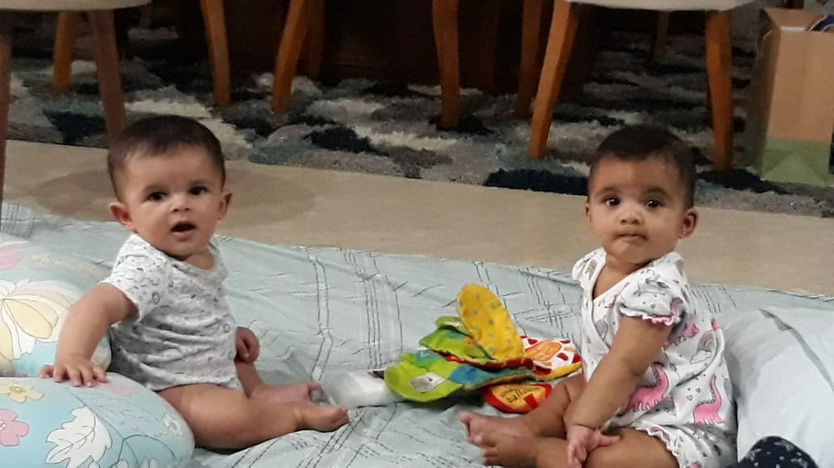


Slide 4



Slide 5
agenda
Orientation
First project
SQL refreshment
Python refreshment
Breakout room

Slide 6
Points to consider
Connect session same time same day
Revoking
Better come prepared
Raise hand tool
Ask for help tool
Plagiarism

Slide 7






Getting started
Notes:
Ask questions
Answer questions
Post resources
Share ideas of projects and ask for collaborators
Share life hacks
Share job opportunities

Slide 8
Flask experience poll

Slide 9

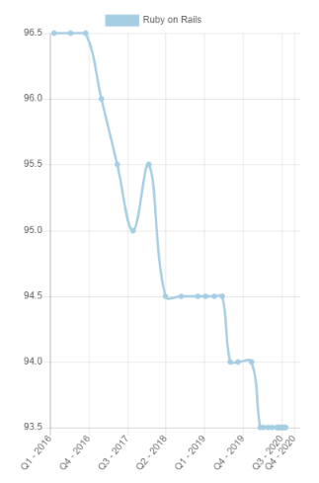
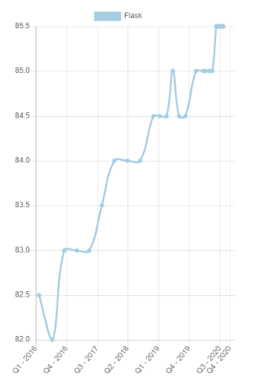
Why flask ?
Notes:
https://hotframeworks.com/
Very easy to use
Top ranked framework

Slide 10

العركة

Slide 11


Flask vs django
Comparison | FLASK | DJANGO
Nature | Minimalistic | Batteries-included
Companies
When to use ? | 1- python beginner 2-need freedom 3- a simple APP ?? | 1- python experienced user 2- complicated app
Notes:
Can flask make complicated apps ?

Slide 12
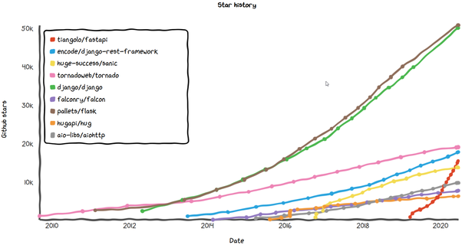

Fastapi
Waiting for ur input …
Notes:
Tell us how can we do this in FASTAPI, in another FLASK extension, in Django… , etc

Slide 13

العقبات
1- setup (survey)
2- prerequisites (survey)
3- workspace
4- starter code
4- projects
5- deadlines

Slide 14
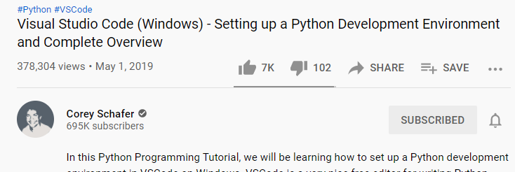
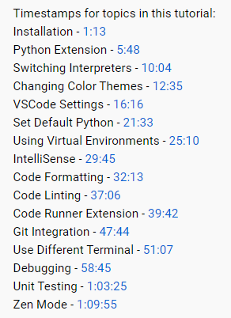
Vs and python

Slide 15
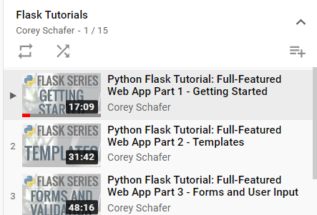

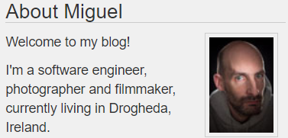
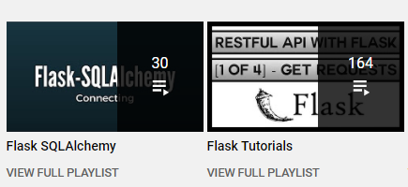
How to start?
Notes:
https://hackersandslackers.com/series/build-flask-apps/
https://www.youtube.com/c/PrettyPrintedTutorials/playlists
https://blog.miguelgrinberg.com/post/the-flask-mega-tutorial-part-i-hello-world
Flask Tutorials – corey Schafer –YouTube
https://www.youtube.com/playlist?list=PL-osiE80TeTs4UjLw5MM6OjgkjFeUxCYH

Slide 16
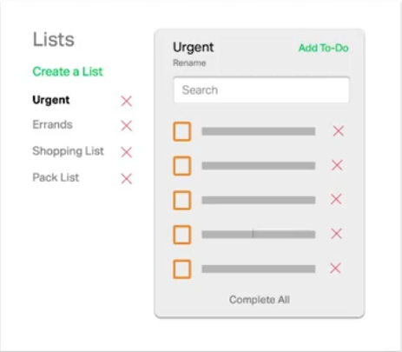
overview

Slide 17
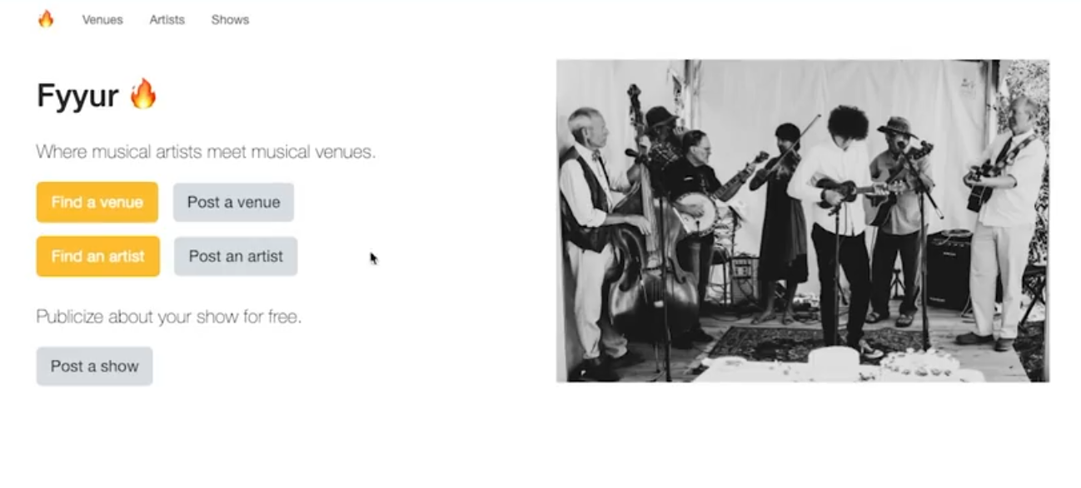
Project 1
Notes:
Musical venues : مسارح \ نوادي للموسيقى

Slide 18
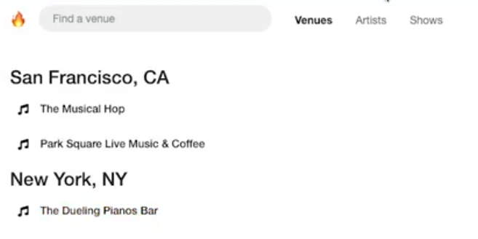

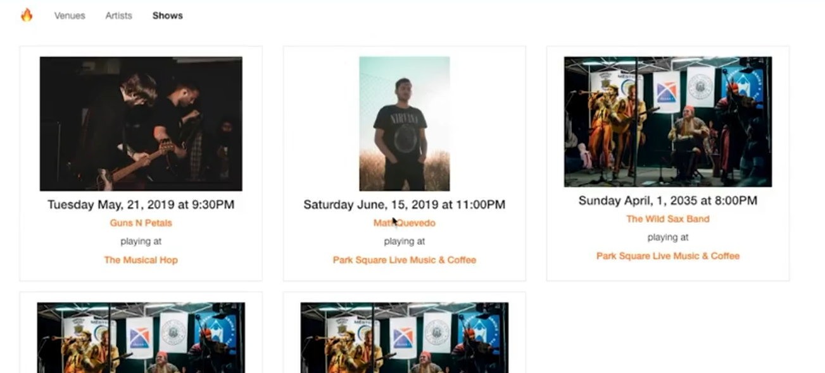

Slide 19
Project 1
Notes:
Musical venues : مسارح \ نوادي للموسيقى

Slide 20
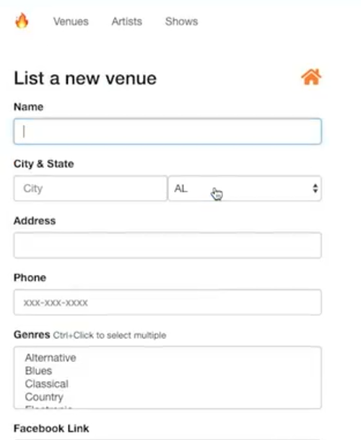
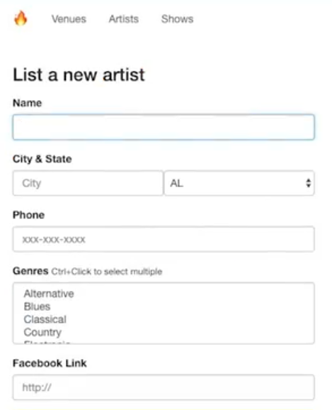
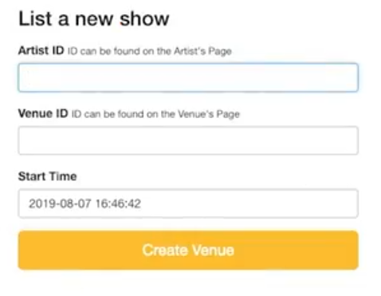

Slide 21

Fake vs Real data
Notes:
Not really about front end
Mainly Flask and connecting it with database through SQLAlchemy

Slide 22
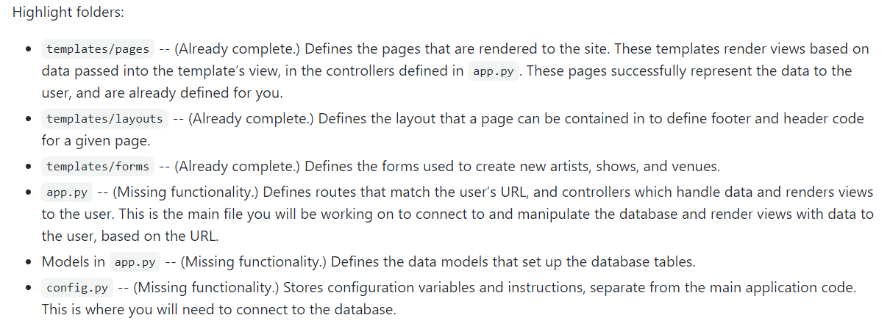
Project requirements

Slide 23
Rubric
Fyyur: Artist Booking Site
https://review.udacity.com/#!/rubrics/2653/view

Slide 24
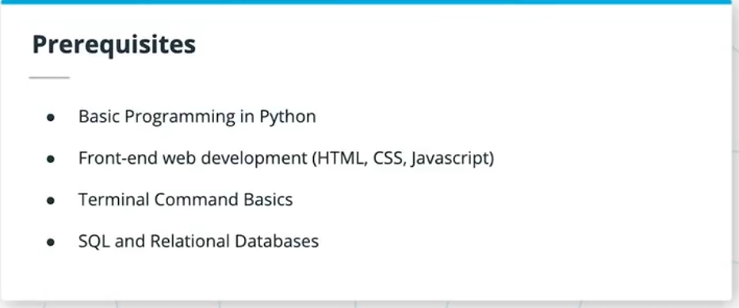
Notes:
Python .. U need basic .. But if u want to excel beyond this ND, u will need python a lot u need OOP in python.. Mainstay for database handling
HTML .. Intermediate forms/ data-id/
CSS intro course basics and to be able to search what u need classes / id
JS realtively advanced .. But won’t be used for the future. (promises/ event handlers)
U will find implementation in react and npm
Terminal .. Very Basics refer to the course shell .. Try downloading the videos and watch in VLC
SQL cheat sheet .. Not really important.. U will be using ORM

Slide 25
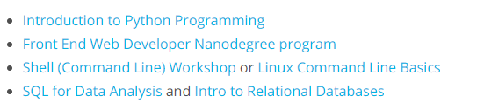
Notes:
Intro to JS https://classroom.udacity.com/courses/ud803 good but basic
Intro to HTML and CSS https://www.udacity.com/course/intro-to-html-and-css--ud001 good but basic
SQL for data analysis https://www.udacity.com/course/sql-for-data-analysis--ud198 .. I think u don’t need to wast ur time … maybe u can watch the first few videos
Front End Web developer no access
Intro to Relational database really good I got many slides from it. https://www.udacity.com/course/intro-to-relational-databases--ud197
Shell (command line) workshop really good

Slide 26

github

Slide 27
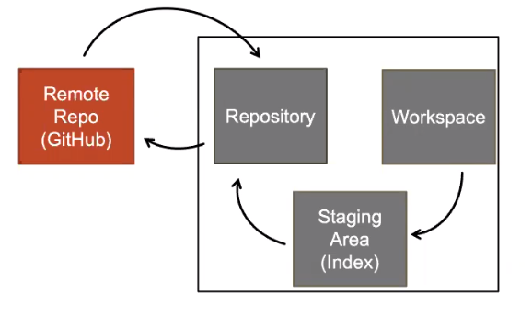
Git Flow

Slide 28
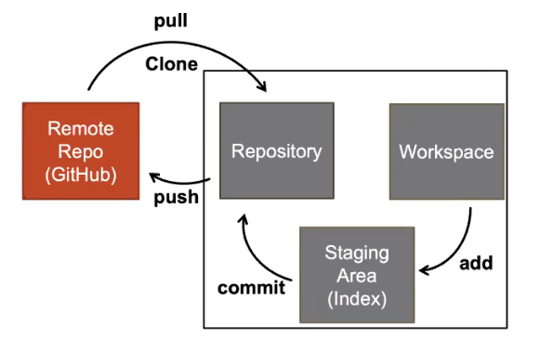
Git Flow

Slide 29
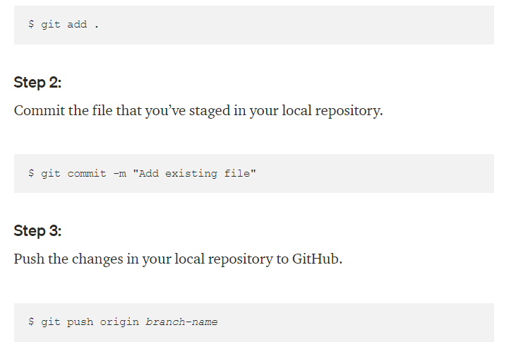
Anything easier?

Slide 30
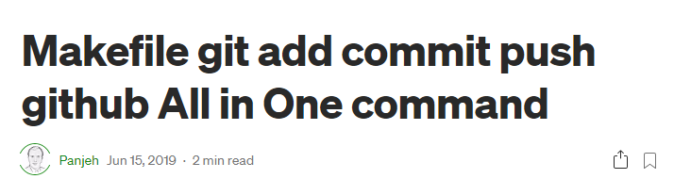

Slide 31
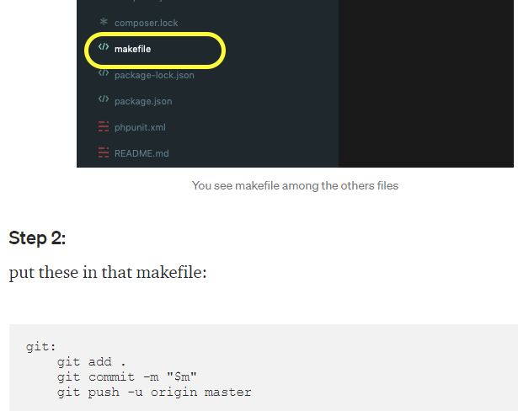

Slide 32
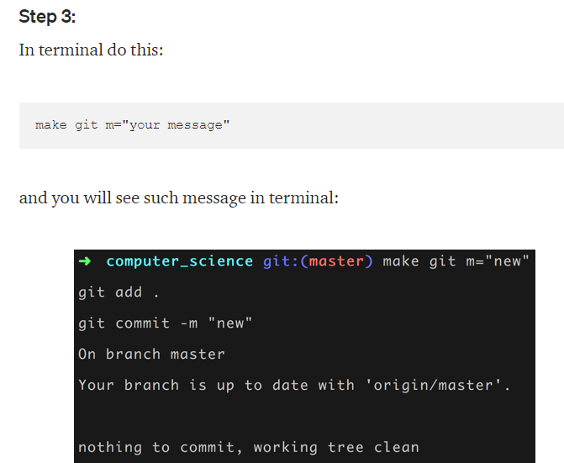

Final touch
Notes:
I tried it on WSL and it worked.
It failed on windows as it is a GNU/LINUX command
https://medium.com/@panjeh/makefile-git-add-commit-push-github-all-in-one-command-9dcf76220f48
https://stackoverflow.com/questions/32127524/how-to-install-and-use-make-in-windows

Slide 33
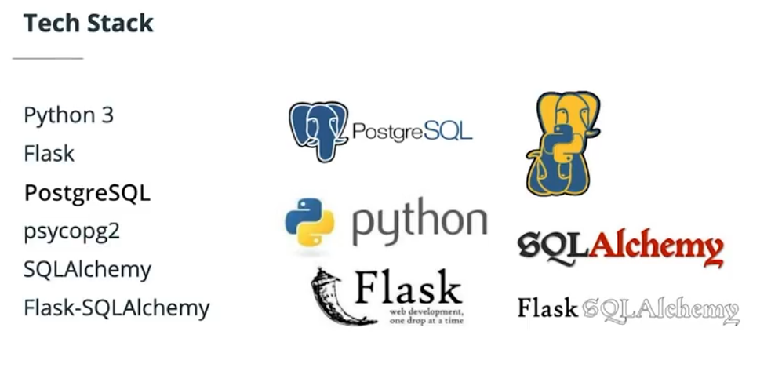
Notes:
SQLALCHEMY and flask-SQLALCHEMY .. U import one from the other
Psycopg2 .. Connection ,,, u will never bother.
PostgreSQL .. U won’t in fact be interacting with it. U will be using SQLALCHEMY
Flask and python3 …. A lot.

Slide 34

Pop quiz
والجوائز ايه يا أستاذ ؟

Slide 35

complete
الخناقة كانت على 10 متر سيراميك ..

Slide 36

sql

Slide 37
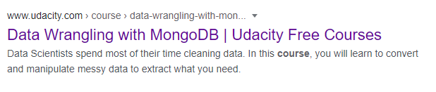
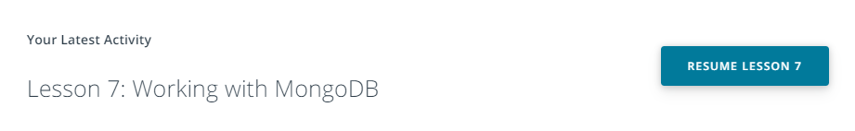
NOSQL?
Notes:
NoSQL course udacity - Google Search
https://www.google.com/search?q=nosql+course+udacity&oq=nosql+course+udacity+&aqs=chrome..69i57j33i160.14718j0j7&sourceid=chrome&ie=UTF-8

Slide 38
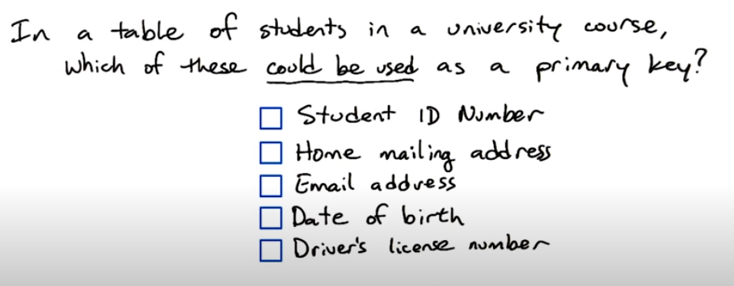
Primary key
Notes:
Mailing address : sharing the same house
Email address : ok but maybe it is changed one day
DOB: maybe unique but a primary key has to be unique
Driver’s license No: some students don’t drive

Slide 39
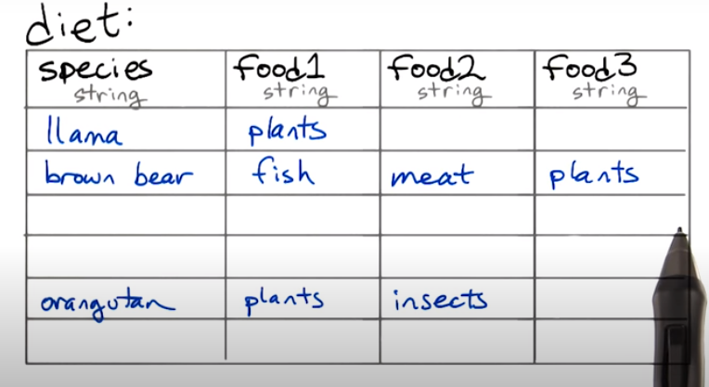
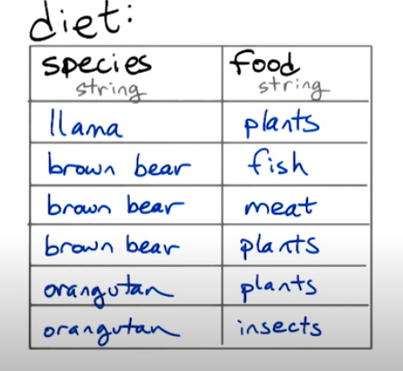
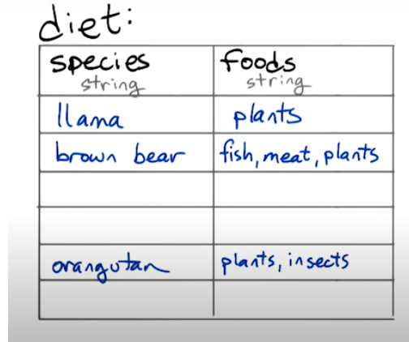
queries
Notes:
The left table works better with joins, with aggregations and you don’t need to know the different types of food in advance.
In addition, no missing data

Slide 40
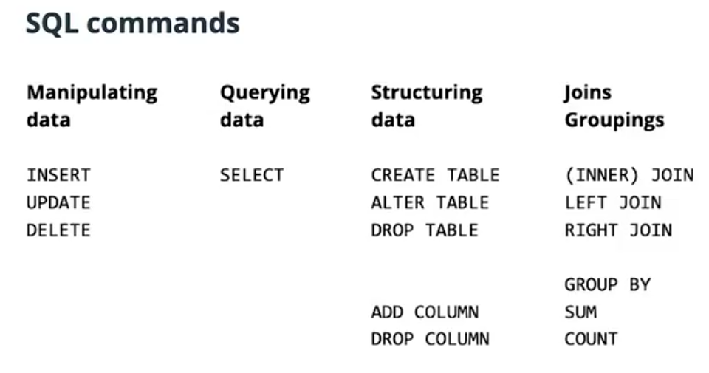
Notes:
Part 2 Lesson 2 section 4

Slide 41
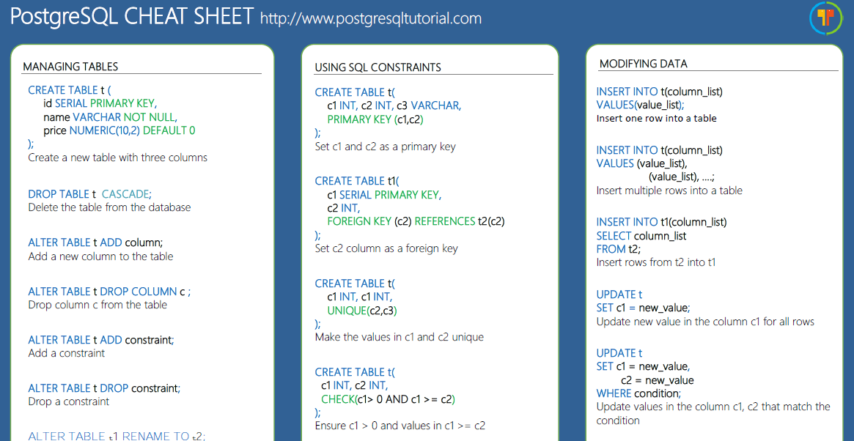
CHEAT SHEET
https://www.postgresqltutorial.com/postgresql-cheat-sheet/

Slide 42
Design tables in psql (breakout)
thief = Thief()
thief.name = “awad abo shaaf”
thief.age = 27
thief.items = {
“item1”: “gold watch”
“item2”: “mobile phone”
}

Slide 43
Solution
ID | Name | Age
1 | Awad abo shaaf | 27
2 | hima
ID | Object_descriptiuon | Thief_id
1 | Gold watch | 1
2 | Mobile phone | 1
 | 5alat | 2

Slide 44
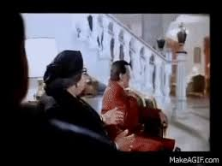
foffa

Slide 45
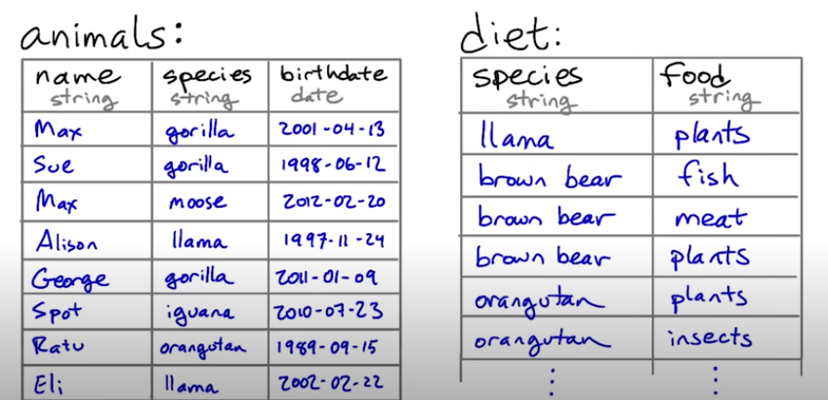
join
Select animals that eat fish

Slide 46
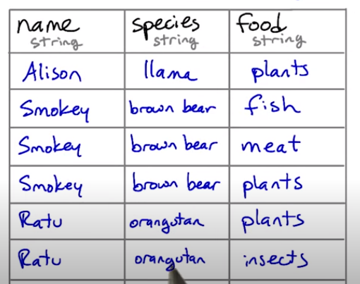
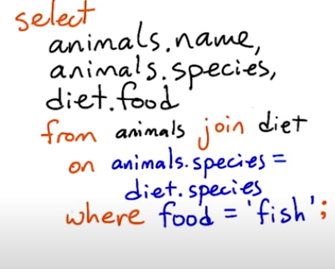
Generate the new table

Slide 47
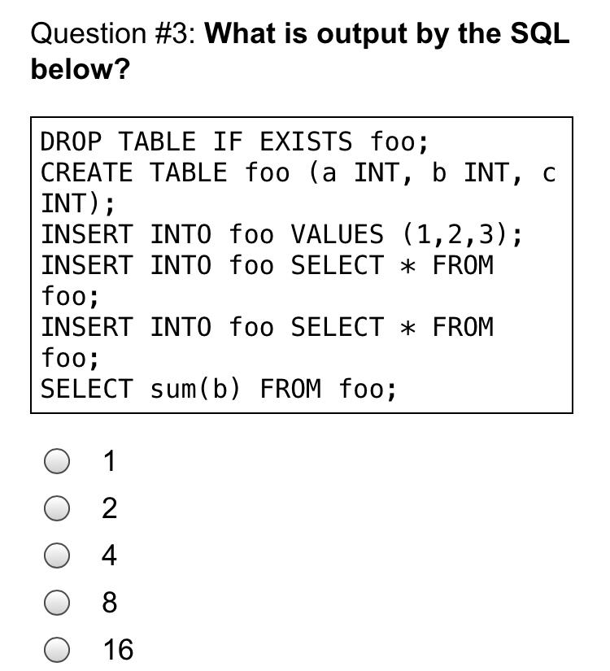
Guess the output
Notes:
8

Slide 48
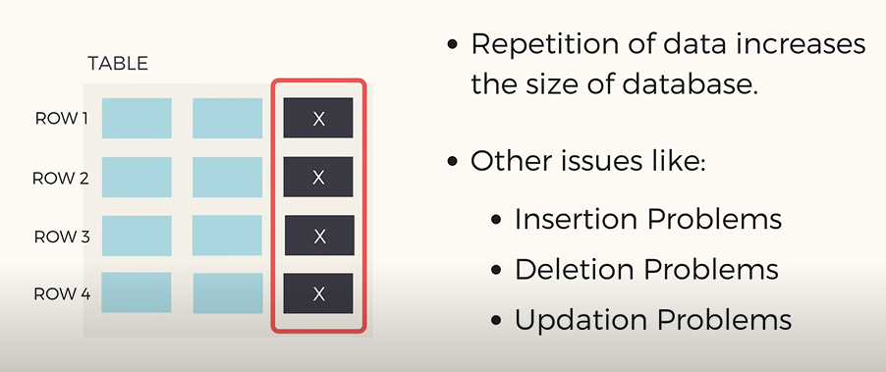
normalization
Notes:
Minimize redundancy

Slide 49
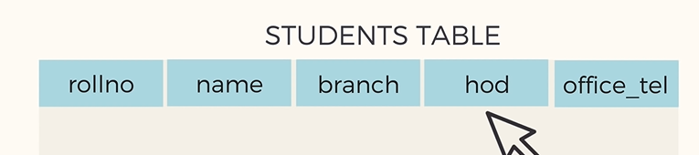
What’s the problem?
Notes:
Hod: head of department

Slide 50
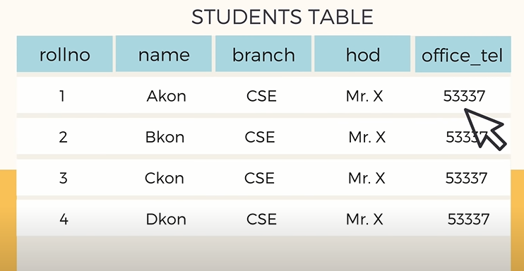
Apart from redundancy, are there any other problems?

Slide 51
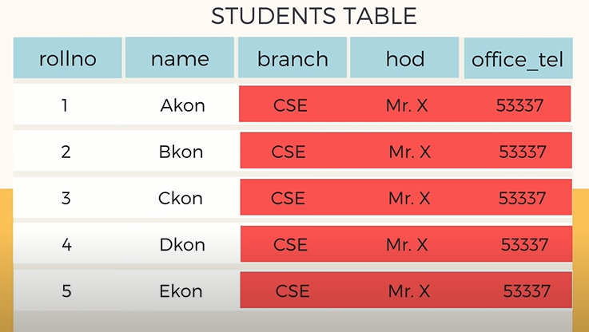


Insertion anomaly
What if we want to add 100 students?

Slide 52
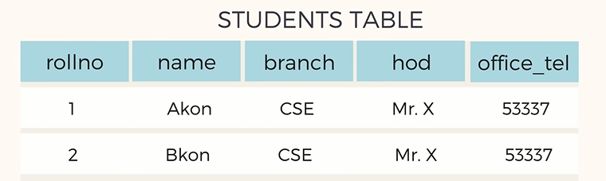
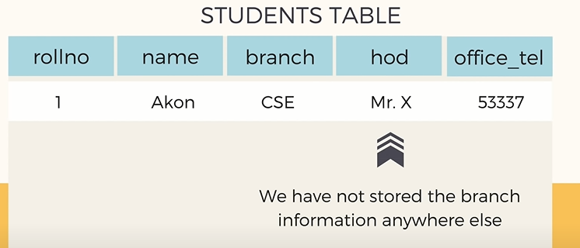

Deletion anomaly

Slide 53
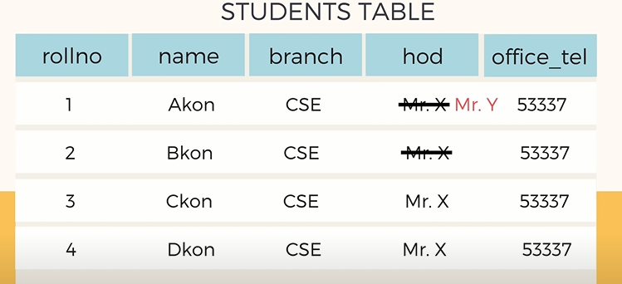
modification anomaly

Slide 54
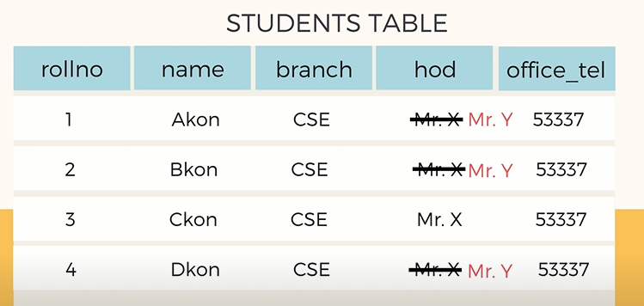
Do for all and never miss
How to solve?
Notes:
If one is missed, there will be inconsistencies

Slide 55
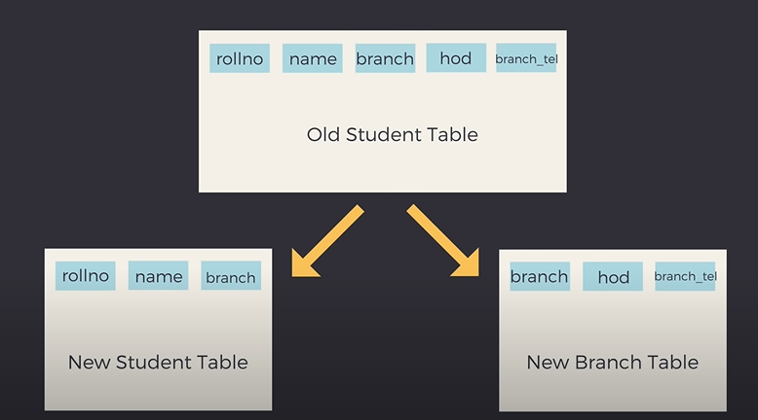
solution

Slide 56
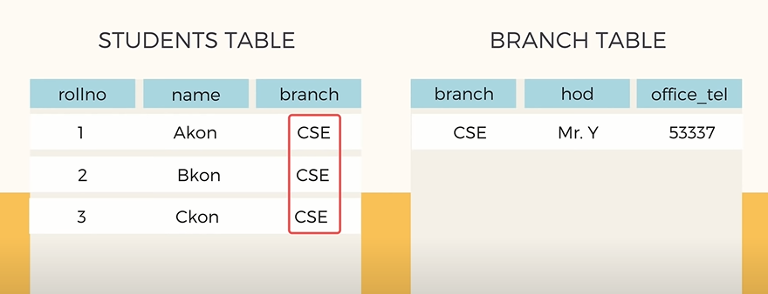
Eliminate redundancy?
Notes:
One can say that there is still redundancy
Normalization is about minimizing redundancy not eliminating it.

Slide 57
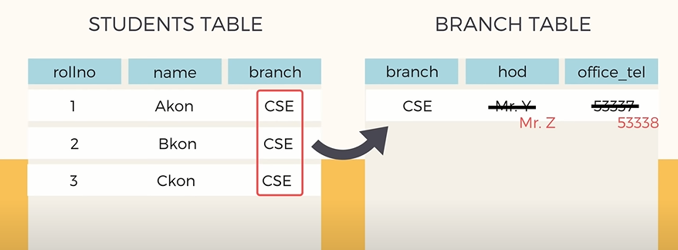
Insert, Update & delete now?
Notes:
Automatically updated for all students’ records

Slide 58

Deletion solved

Slide 59

Rules of normalization
unique primary key
Non-key relate to primary key
Non-key don’t relate to each others.
One more?

Slide 60

Normalized design
Notes:
Every row should have the same number of columns

Slide 61

Normalized design
Notes:
Every row should have the same number of columns

Slide 62

Every column relates to primary key

Slide 63

Address describes key or non-key?
Notes:
It may describe both, but this is a problem Third normal form is violated when a non-key field is a fact about another non-key field
Problems: 1- address is repeated in every record that has the same location
2- If the address of ducky park changes, every record referring to the park must be updated.
3- Because of the redundancy, the data might become inconsistent, with different records showing different addresses for the same warehouse. (simply because u have to update everything, u may miss things)
If at some point in time there are no parts stored in the warehouse, there may be no record in which to keep the warehouse's address.

Slide 64

solution

Slide 65

What’s the problem?
Notes:
Consider employees, skills, and languages, where an employee may have several skills and several languages. We have here two many-to-many relationships, one between employees and skills, and one between employees and languages
Several policies are possible for maintaining two independent multi-valued facts in one record:

Slide 66





Possible representations
Notes:
What does blank mean? Missing, or no skill or Not Applicable ?
If there are repetitions, then updates have to be done in multiple records, and they could become inconsistent.
Insertion of a new skill may involve looking for a record with a blank skill, or inserting a new record with a possibly blank language, or inserting multiple records pairing the new skill with some or all of the languages.
Deletion of a skill may involve blanking out the skill field in one or more records (perhaps with a check that this doesn't leave two records with the same language and a blank skill), or deleting one or more records, coupled with a check that the last mention of some language hasn't also been deleted.

Slide 67

How to solve?

Slide 68

Implying relationships
Notes:
http://www.bkent.net/Doc/simple5.htm
Not only this
Think of the conflict,, they can input data in a variety of ways

Slide 69
Rules of normalization
unique primary key
Non-key relate to primary key
Non-key don’t relate to each others.
2 columns with many to many

Slide 70

What’s normalized
Notes:
1 missing id
2 unrelated columns (student name and course and grade ) grade describes the course not the name or ID

Slide 71

answer

Slide 72

Always normalize
Notes:
Genres should be added as another table or an array of strings
U can choose whatever u wish

Slide 73


Slide 74

أفضل سيناريو

Slide 75

Foreign key constraint

Slide 76

Foreign key
Each voter can
vote only once
on a single post

Slide 77


Slide 78




Notes:
Psql not case sensitive.. It actually converts everything to lower case MYSQL is case senstive
Don’t use double quotes
PGAdmin might be a useful and friendly way to manage your databases, it also automatically uses double quotes when creating tables. This means that if you create a table with PGAdmin, you might find yourself struggling to find or query it afterwards
Double quotes may mean that u may need to access tables or columns using double quotes each time u use them
https://lerner.co.il/2013/11/30/quoting-postgresql/

Slide 79


PSQL
https://www.postgresql.org/docs/9.5/manage-ag-templatedbs.html
Notes:
Object-relational support includes support for arrays (multiple values in a single column), and inheritance (child-parent relationships between tables).
Has multi-version concurrency control, avoiding unnecessary locking when multiple writes are happening to the database at once (avoiding waiting times for access to the database) Postgres lets you have several databases available for reading from and writing to, at once.
Offers great performance and many indexing capabilities for optimizing query performance
PostgreSQL is also often just called Postgres, and we'll be using both terms interchangeably throughout this course.

Slide 80

PSYCOPG2
Notes:
Cursor is an interface to start queuing up work and transactions

Slide 81

Things getting easier

Slide 82



Psycopg2
Notes:
Safety : SQL injection
One size fits all: different SQL dialects
Easy,, wait till u see SQLALCHEMY
String manipulation? A disaster

Slide 83
Why transactions?
Notes:
Cursor is an interface to start queuing up work and transactions

Slide 84

python

Slide 85

Better idea?

Slide 86


Which is better?
Notes:
Intro to programming nanodegree

Slide 87

Working or broken ?

Slide 88


solution
Notes:
1- str in list doesn’t matter
3- indentation

Slide 89

Infinite list

Slide 90

A better loop

Slide 91

indexing

Slide 92


Slide 93

range

Slide 94

solution

Slide 95

F strings

Slide 96

solution

Slide 97

F strings

Slide 98


Slide 99


Slide 100

sets
Notes:
Ans : 6

Slide 101

sets
Notes:
maybe

Slide 102

dictionary

Slide 103


Dictionary

Slide 104

solution

Slide 105
How to add a pair?

Slide 106

Adding a pair

Slide 107

List comprehension

Slide 108

solution

Slide 109

What’s the mistake in here ?
Notes:
In this case, if it is happy, color will be gray, because the second if will run
The else is linked to the latest if

Slide 110

Solution

Slide 111
PS1=’>’
Terminal command so that working directory won’t appear.

Slide 112

functions

Slide 113

functions

Slide 114

functions

Slide 115

solution

Slide 116

Print and return from a script
Notes:
Only bears

Slide 117

Print and return from a file
Notes:
It prints the word none

Slide 118


Print and return from interpreter
Notes:
Prints hello to the console

Slide 119

Print and return from interpreter
Notes:
Both bears and 42 appeared in the terminal.
Like we saw earlier, there is a difference between returning a value and printing a value. There's also a difference in how these things behave depending on whether you're running them from a file or from interactive mode. In interactive mode, you'll see values that get printed and also any returned values (even when they aren't printed).

Slide 120


User input
Notes:
String

Slide 121

Handling errors

Slide 122


solution

Slide 123


Notes:
The client sends a request to the server, including information about the request type and any user input data.
The server receives the request, and uses the user input data to determine how to shape its request to the database, and sends a request to the database.
The database processes this request, and sends a response back to the web server.
The server receives the response from the database, and uses it to determine the view + powers the view template with the fetched data, sending it back to the client's browser.
The client is responsible for rendering something to the user, that represents both the data and its representation.

Slide 124


HTML
PYTHON
Notes:
Clicking on the Polo product leads to a click event being registered by the browser, on the client computer.
A click handler in the view would send a request to the server (in Javascript) from the client browser.
A client could request more data and a different view to be rendered (with that data).
A server process listens to the request sent from the view. It fetches the data and chooses what to render next, using the fetched data.

Slide 125



Slide 126

BREAKOUT ROOMS

Slide 127
# TODOS
Use ba77a for an illustration of CRUD and simple explanations
SQL
1- create schema
2- Add rows
3- Add column
4- Update column constraint
Don’t miss rollback
Pseudo code )1 python and 1 HTML)
1- عرض سندوتش
2- اضافة سندوتش
3- حذف سندوتش
4-تعديل سندوتش (اضافة سلطة مثلا )

